Slide 1
Amazon Sales Analysis
Cloth Products
Software Used: Power BI
By Mital Kadu

Slide 2
Problem Statement
The management team of Amazon currently looking to understand market behavior and sales trend to gain a competitive advantage. The objective of the project is to create a report on Sales trend year-wise, month-wise to understand the factors directly affecting the sales. This project aims apply Business Intelligence tool such as Power BI to get a visual understanding the sales data.

Slide 3
Data Description:
The Dataset consists of following columns:
Category: Type of product.
Size: Size of the product.
Date: Date of the sale.
Status: Status of the sale.
Fulfilment: Method of fulfilment.
Style: Style of the product.
SKU: Stock Keeping Unit.
ASIN: Amazon Standard Identification Number.
Courier Status: Status of the courier.
Qty: Quantity of the product.
Amount: Amount of the sale.
B2B: Business to business sale.
Currency: The currency used for the sale.

Slide 4
Data Cleaning
Removed the “Unnamed_22” column mainly because it mostly contained null values.
In the columns “ship_city,” “ship_state,” and “ship_country,” there were 33 rows with null values, and I chose to drop.
Null values in the “promotion_ids” column, particularly in orders without promotions, a practical solution is to replace these null entries with the label ‘No promotion.’

Slide 5
Data Cleaning
For clarity in the “fulfilled_by” column, where the method for delivery is indicated by two values, ‘Easy ship’ and null, I updated the null entries to ‘unknown.’
“Status” column indicated cancellation, I set the order amount to 0. This involved replacing 8,000 null values and 10,000 instances where the amount received for the order was recorded.

Slide 6
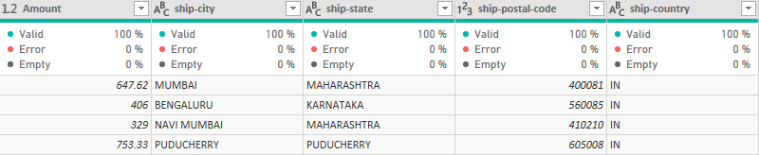
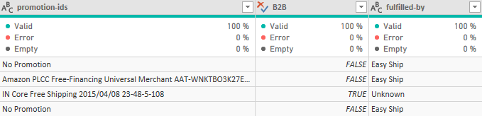

Slide 7
DAX
New Column:
Week = WEEKNUM('Amazon Sale Report'[Date].[Date])
New Measure:
YTD = TOTALYTD(SUM('Amazon Sale Report'[Amount]),'Amazon Sale Report'[Date])
YTD Product sold = TOTALYTD(COUNT('Amazon Sale Report'[Category]),'Amazon Sale Report'[Date])
Total Status = COUNT('Amazon Sale Report'[Status])
Total Order = COUNT('Amazon Sale Report'[Order ID])

Slide 8
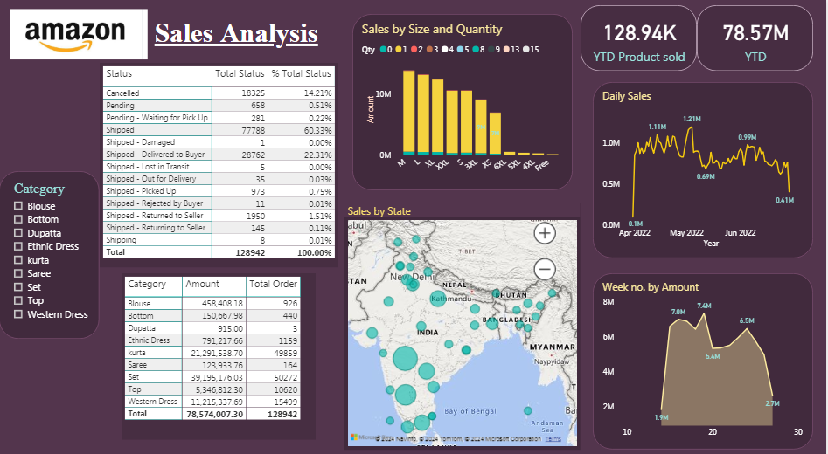
Analysis: Power BI Dashboard

Slide 9
Outcomes
Delving into order status, we encountered 2,112 instances where orders were not received by buyers due to various reasons. Simultaneously, a considerable 18,325 orders faced cancellation for reasons unknown to us, which gives us together almost 16% of the dataset. This percentage underscores the significance of order cancellations.
When considering all available sizes, these three categories astonishingly contribute to 90% of all sales.
The probability of clients buying more than one quantity is minimal, constituting a mere 0.3% of all orders.

Slide 10
Outcomes
Earnings analysis, April emerges as the standout month for this store. Notably, March records have a notably small number of sales, because to the fact that only last day of the month sales data is available from our dataset.
Analyzing the data, it’s evident that 90% of all sales come from just 3 out of 9 categories.

